Slide 1
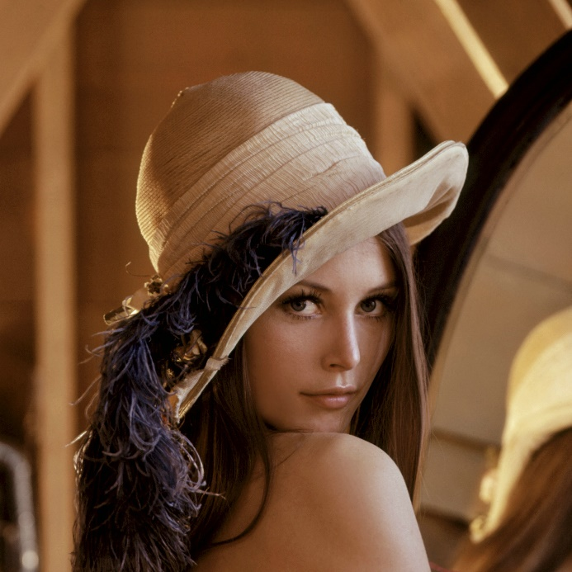


Visión por computador en la nueva era de la Inteligencia Artificial y el Deep Learning
Computer vision in the new era of Artificial Intelligence and Deep Learning
Rubén Usamentiaga*, Alberto Fernándezº
* University of Oviedo
º TSK
Gijón (Spain)
5 – 16 April 2021
https://github.com/albertofernandezvillan/computer-vision-and-deep-learning-course

Slide 2

OpenCV
Image processing in OpenCV
geometric_image_transformations_opencv.ipynb
opencv_sliders_introduction_image_processing.ipynb
visual_interface_image_processing_opencv.ipynb
computational_photography_module_opencv.ipynb
inpaint_algorithm_in_opencv.ipynb
k_means_clustering_opencv.ipynb
face_processing.ipynb
references_for_main_image_processing_techniques_in_opencv.ipynb
geometric_image_transformations_opencv.ipynb
opencv_sliders_introduction_image_processing.ipynb
visual_interface_image_processing_opencv.ipynb
computational_photography_module_opencv.ipynb
inpaint_algorithm_in_opencv.ipynb
k_means_clustering_opencv.ipynb
face_processing.ipynb
references_for_main_image_processing_techniques_in_opencv.ipynb
https://github.com/albertofernandezvillan/computer-vision-and-deep-learning-course
Notes:
Empezar con el ejemplo del tren en la pizarra

Slide 3
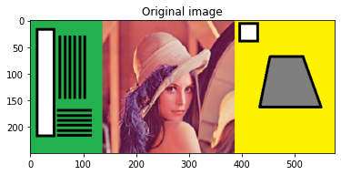
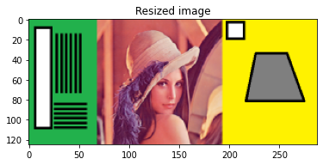

Geometric image transformations: resize
For shrinking: cv2.INTER_AREA and cv2.INTER_CUBIC (slow)
For zooming: cv2.INTER_LINEAR
cv2.resize(image, None, fx=0.5, fy=0.5, interpolation=cv2.INTER_AREA)
cv2.resize(image, (width * 2, height * 2), interpolation=cv2.INTER_LINEAR)

Slide 4
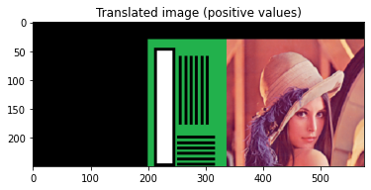
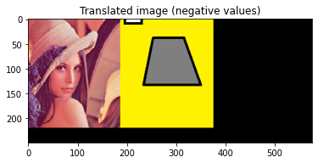
Geometric image transformations: translation
cv2.warpAffine() takes a 2x3 transformation matrix
M = np.float32([[1, 0, 200], [0, 1, 30]])
M = np.float32([[1, 0, -200], [0, 1, -30]])
cv2.warpAffine(image, M, (width, height))
cv2.warpAffine(image, M, (width, height))

Slide 5
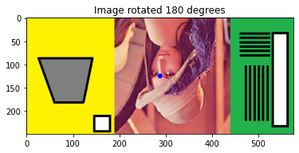
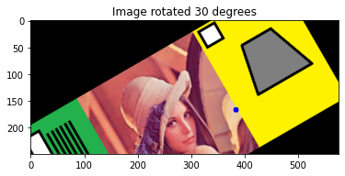
Geometric image transformations: rotation
cv2.warpAffine() takes a 2x3 transformation matrix
M = cv2.getRotationMatrix2D((width / 2.0, height / 2.0), 180, 1)
M = cv2.getRotationMatrix2D((width / 1.5, height / 1.5), 30, 1)
cv2.warpAffine(image, M, (width, height))
cv2.warpAffine(image, M, (width, height))

Slide 6
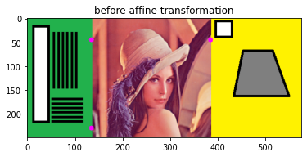
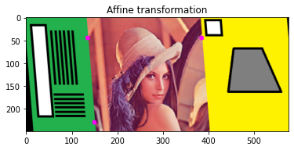
Geometric image transformations: affine
cv2.warpAffine() takes a 2x3 transformation matrix
pts_1 = np.float32([[135, 45], [385, 45], [135, 230]]) pts_2 = np.float32([[135, 45], [385, 45], [150, 230]])
M = cv2.getAffineTransform(pts_1, pts_2)
cv2.warpAffine(image_points, M, (width, height))

Slide 7
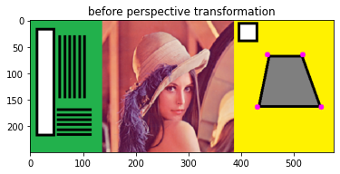
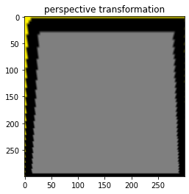
Geometric image transformations: perspective correction
cv2.warpPerspective() takes a 3x3 transformation matrix
pts_1 = np.float32([[450, 65], [517, 65], [431, 164], [552, 164]]) pts_2 = np.float32([[0, 0], [300, 0], [0, 300], [300, 300]])
M = cv2.getPerspectiveTransform(pts_1, pts_2)
cv2.warpPerspective(image, M, (300, 300))

Slide 8
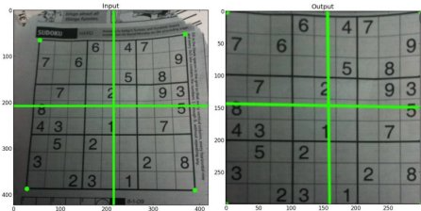
Geometric image transformations: perspective correction

Slide 9
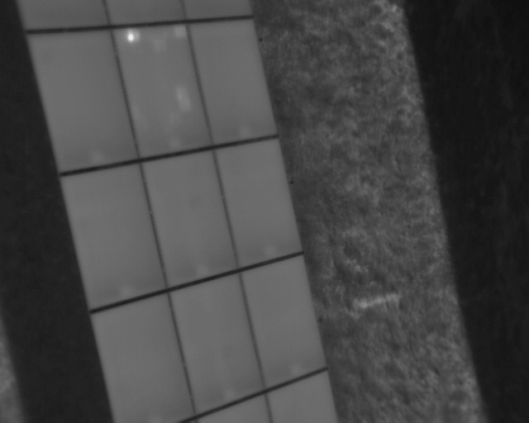
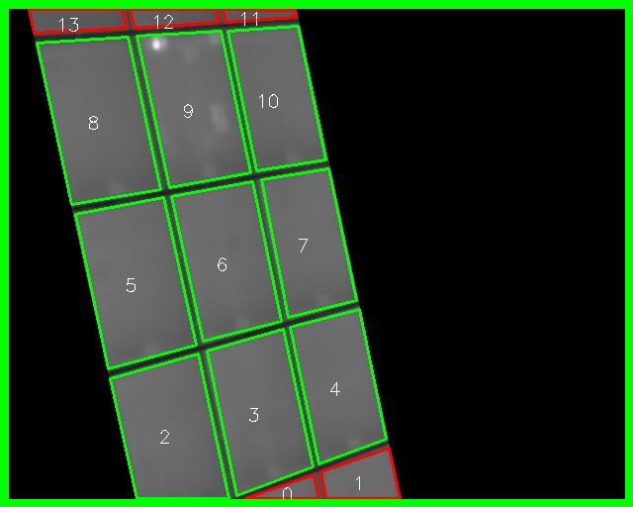
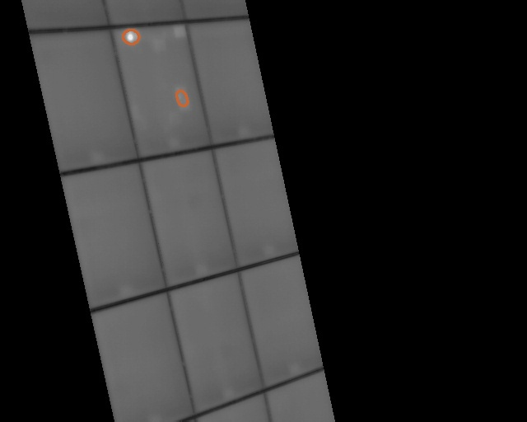
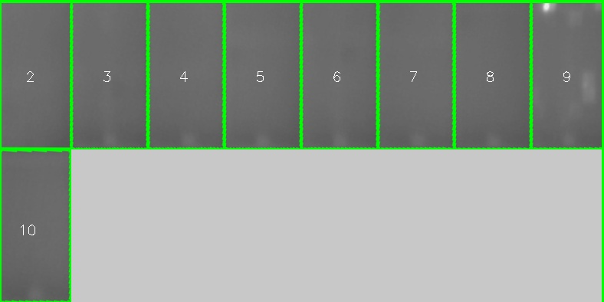
Geometric image transformations: perspective correction

Slide 10
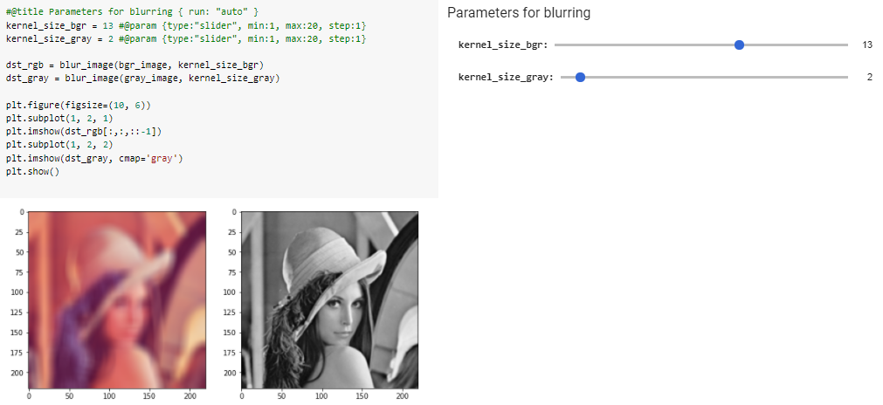
Sliders in Colab for image processing
#@title Parameters for blurring { run: "auto" }
kernel_size_bgr = 13 #@param {type:"slider", min:1, max:20, step:1}
kernel_size_gray = 2 #@param {type:"slider", min:1, max:20, step:1}
def blur_image(src, kernel_size):
result = cv2.blur(src,(kernel_size,kernel_size))
return result

Slide 11
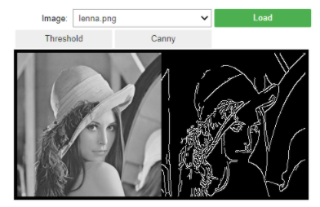
Visual interface for image processing
def display_menu():
selector_box = widgets.HBox([file_selector, load_button])
display(selector_box)
button_box = widgets.HBox([thres_button, canny_button])
display(button_box)
load_button=widgets.Button(description='Load', button_style='success')
thres_button=widgets.Button(description='Threshold')
canny_button=widgets.Button(description='Canny')
file_selector = widgets.Dropdown(options=path_images, description='Image:')
DIR_PATH = '/content'
included_extensions = ('.jpg','.jpeg', '.png')
path_images = [f for f in os.listdir(DIR_PATH) if any(f.endswith(ext) for ext in included_extensions)]
Full code in: visual_interface_image_processing_opencv.ipynb

Slide 12
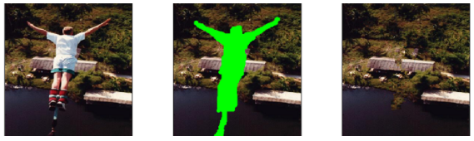
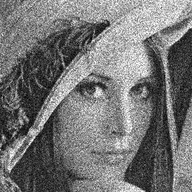
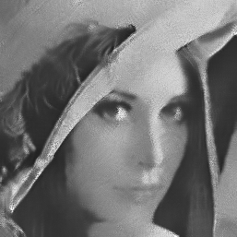
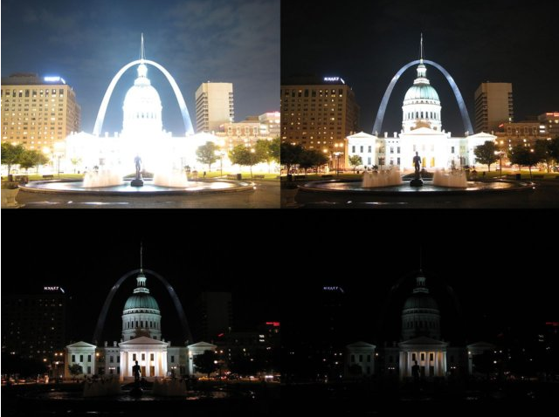
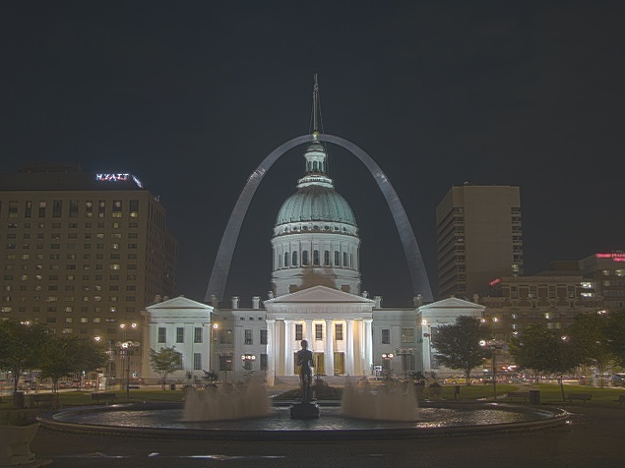
Computational photography module in OpenCV
inpainting
Denoising
HDR imaging

Slide 13
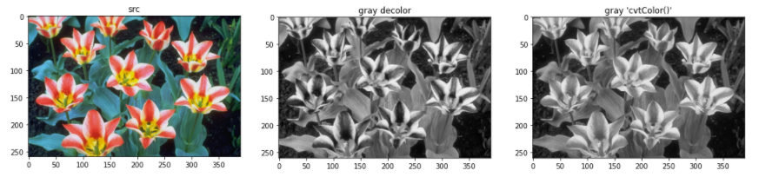
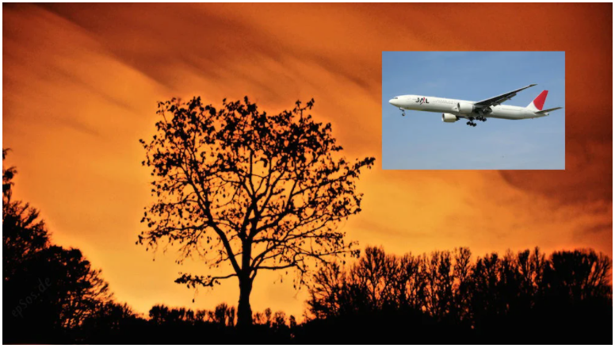
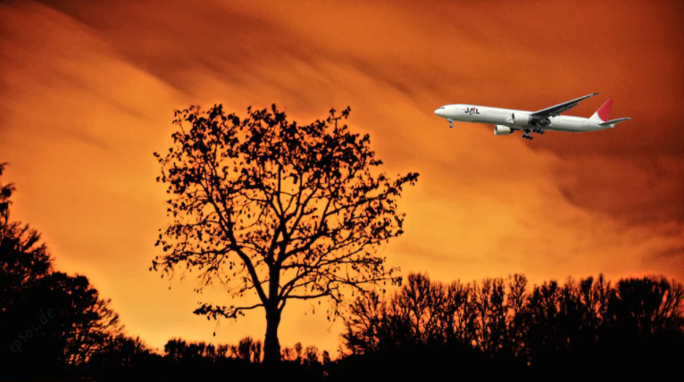
Computational photography module in OpenCV
Contrast Preserving Decolorization
Seamless Cloning

Slide 14
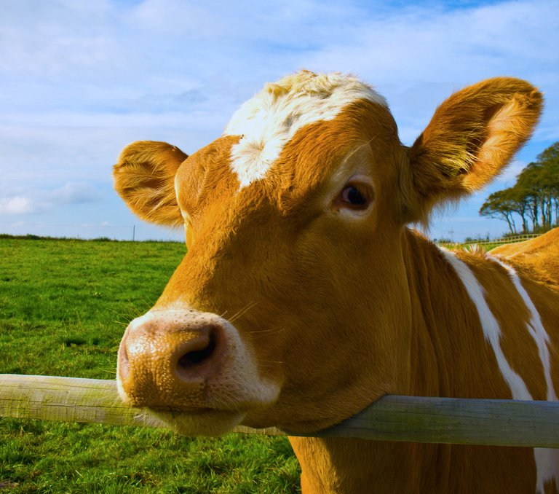
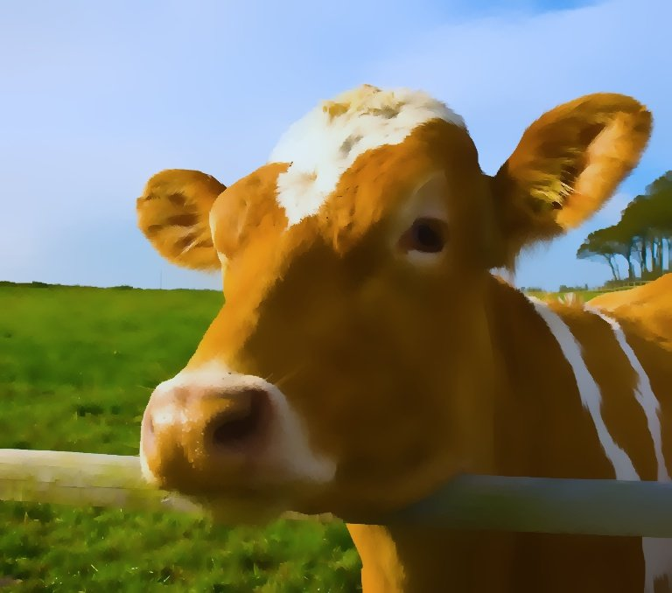
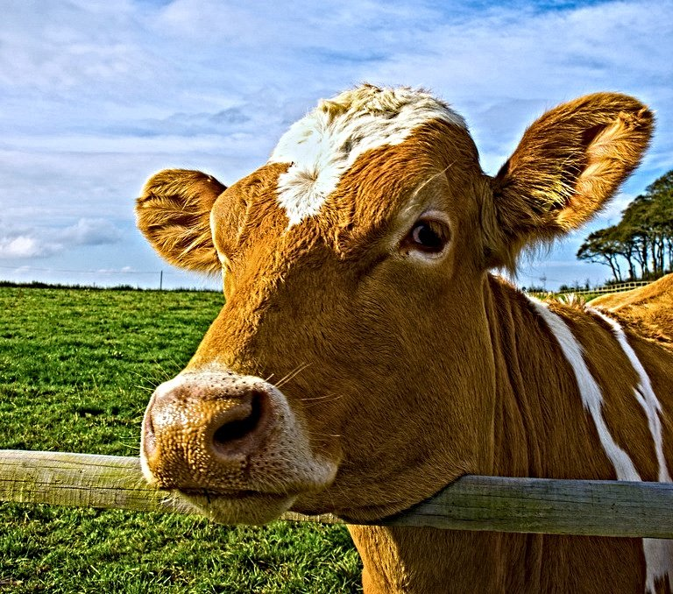
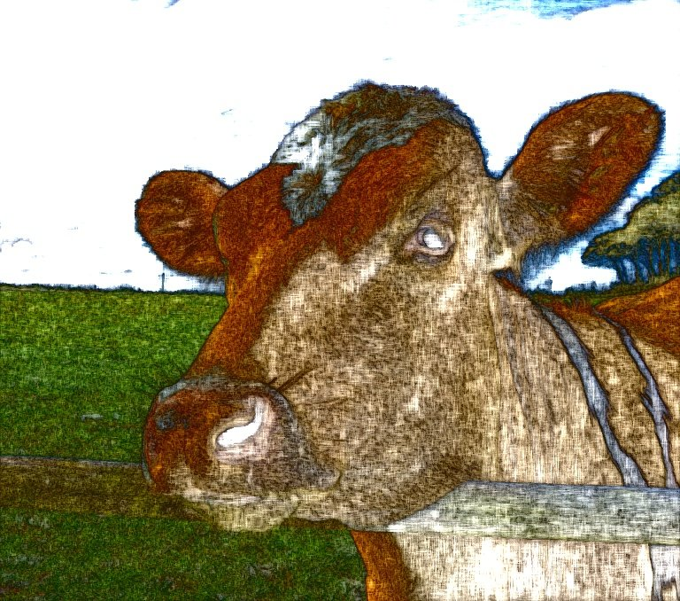
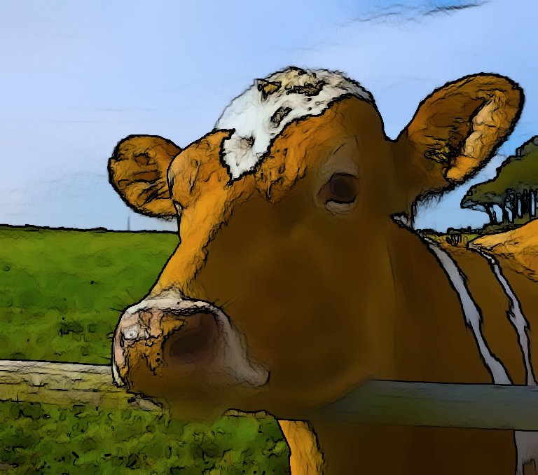
Computational photography module in OpenCV
Non-Photorealistic Rendering
source image
edgePreservingFilter
detailEnhance
pencilSketch
stylization
Link cow image
Images taken from here

Slide 15
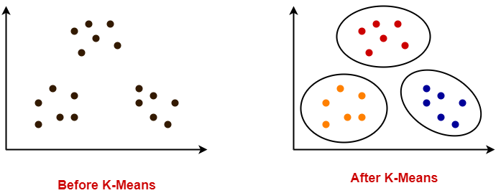
K-means clustering OpenCV
k-means clustering is a method that aims to partition n observations into k clusters in which each observation belongs to the cluster with the nearest mean
K = 3

Slide 16
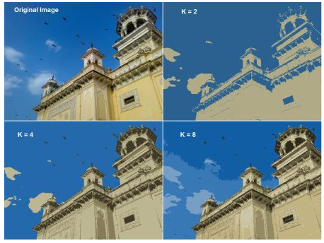
K-means clustering OpenCV
Color Quantization using K-means
Image taken from here
cv2.kmeans(data, k, None, criteria, 10, cv2.KMEANS_PP_CENTERS)

Slide 17
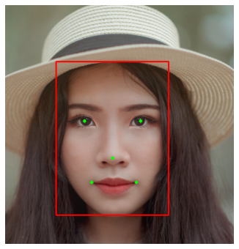
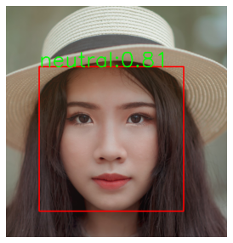
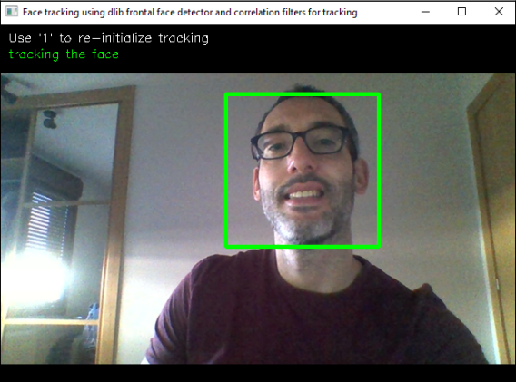
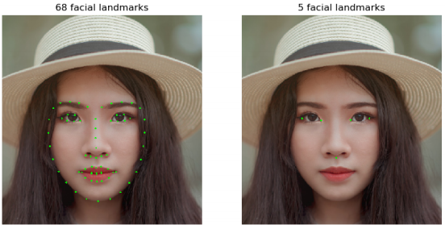
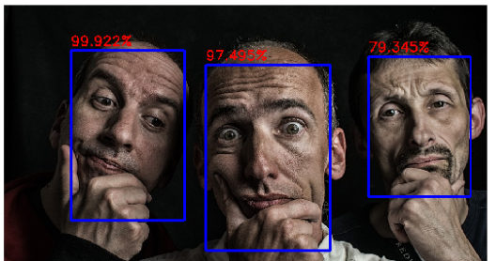
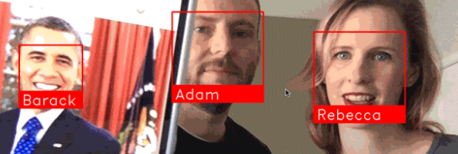
Face processing
MTCNN: Face and facial landmarks detection
FER: Facial expression recognition
Face tracking using correlation filters and dlib library
Facial landmarks using dlib
Face detection with OpenCV and DNN module
See face_processing.ipynb for
implementations and references
face recognition using face_recognition

Slide 18
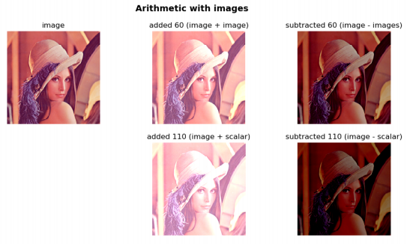
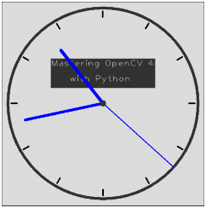
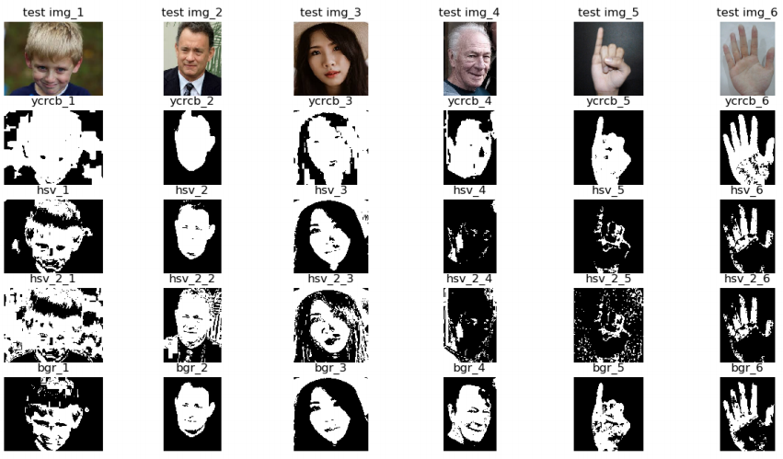
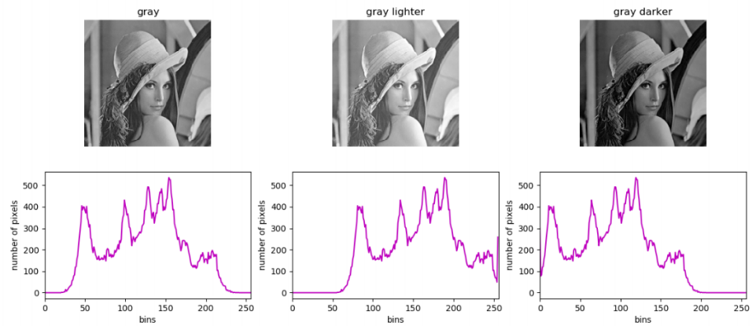
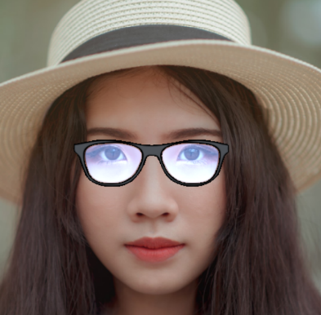
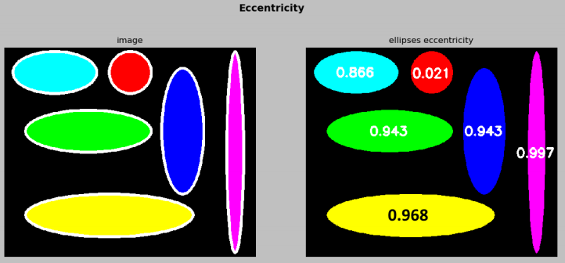
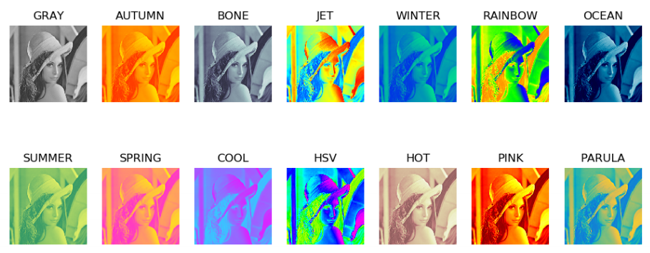
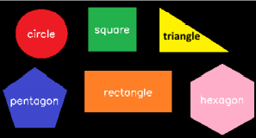
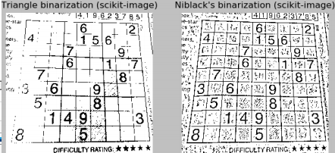
Summary of image processing in OpenCV
references_for_main_image_processing_techniques_in_opencv.ipynb
references_for_main_image_processing_techniques_in_opencv.ipynb

Slide 19
OpenCV
Image processing in OpenCV
https://github.com/albertofernandezvillan/computer-vision-and-deep-learning-course
Notes:
Empezar con el ejemplo del tren en la pizarra

